Slide 1

Rockbuster Stealth LLC
Data Analysis Project
Petar Kletnikoski

Slide 2
INTRODUCTION
Rockbuster Stealth LLC is a movie rental company that used to have stores around the world.
The management team is planning to use its existing movie licenses to launch an online video rental service in order to stay competitive.
The project goal for Rockbuster Stealth LLC's business intelligence (BI) initiative is to to empower the company 2020 launch strategy of its new online service.
The objective is to make data-driven decisions for sustained competitiveness against streaming giants like Netflix and Amazon Prime.

Slide 3
KEY QUESTION AND OBJECTIVES
Which movies contributed the most/least to revenue gain?
What was the average rental duration for all videos?
Which countries are Rockbuster customers based in?
Where are customers with a high lifetime value based?
Do sales figures vary between geographic regions?

Slide 4
DATA OVERVIEW
1000 Flims in the Database.
599 Customers.
Most often occuring language English.
Average Rental duration 5 days.
Average Rental rate - $2.98
Average Replacement cost - $19.98
Average Film Length - 115 min.
Most often occurred Film rating PG-13.

Slide 5
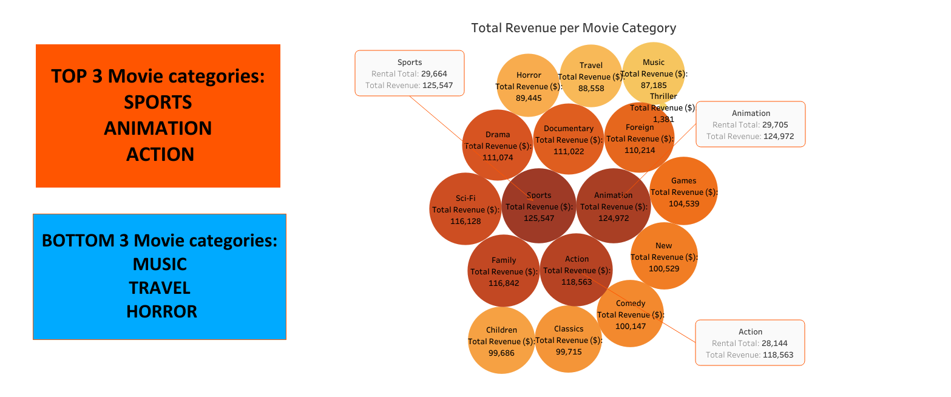
REVENUE PER MOVIE CATEGORY

Slide 6
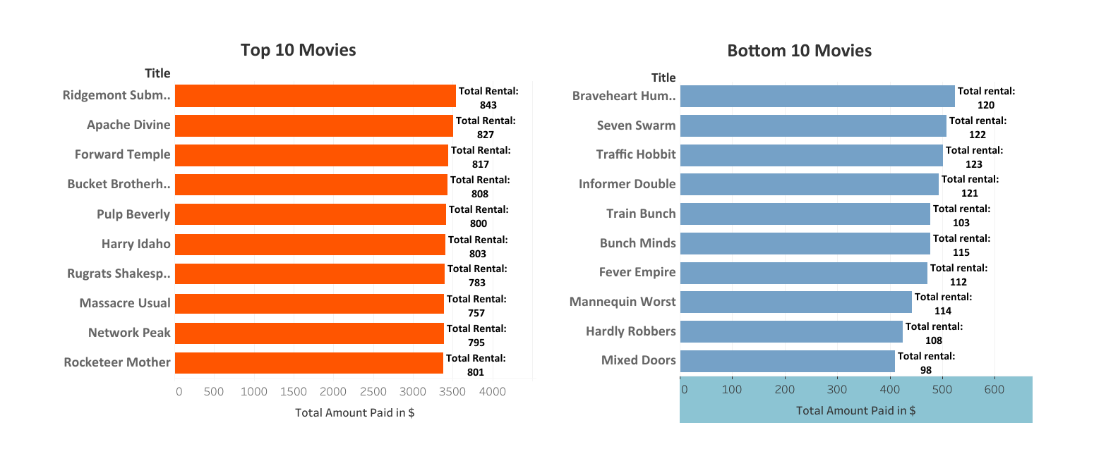
MOVIES CONTRIBUTION TO REVENUE GAIN

Slide 7
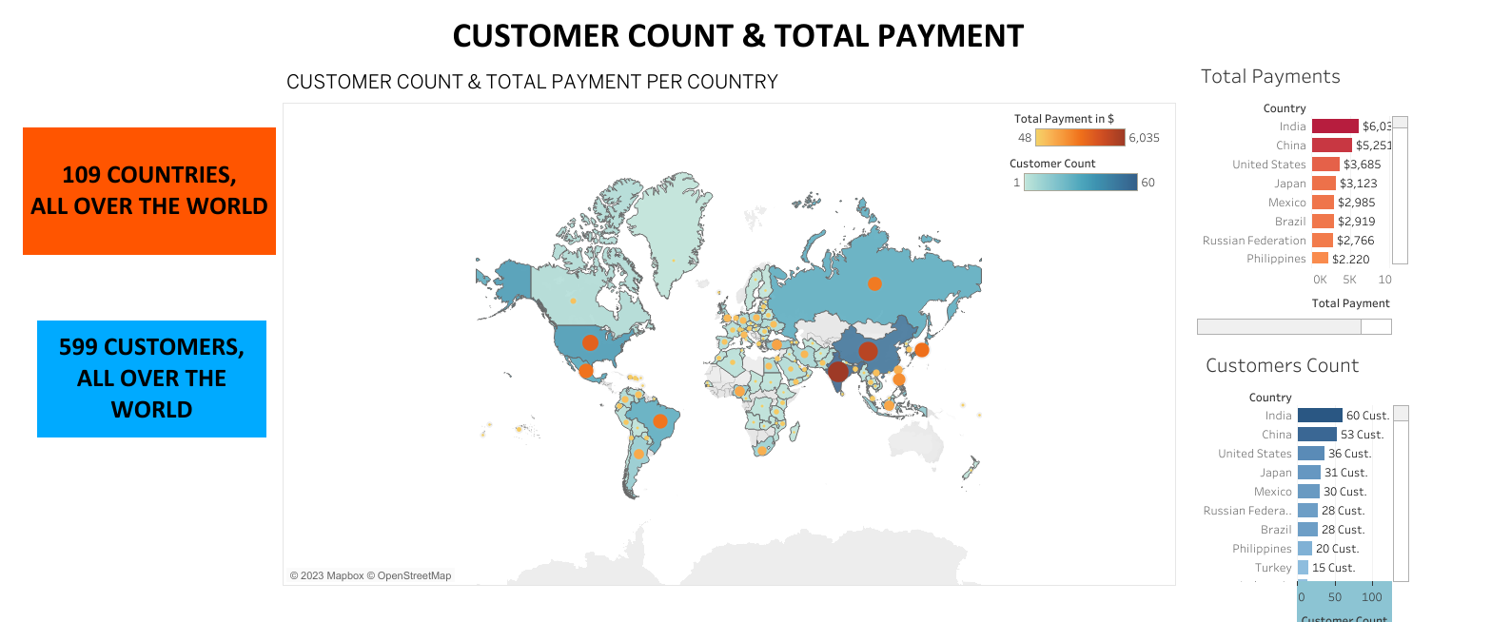

Slide 8
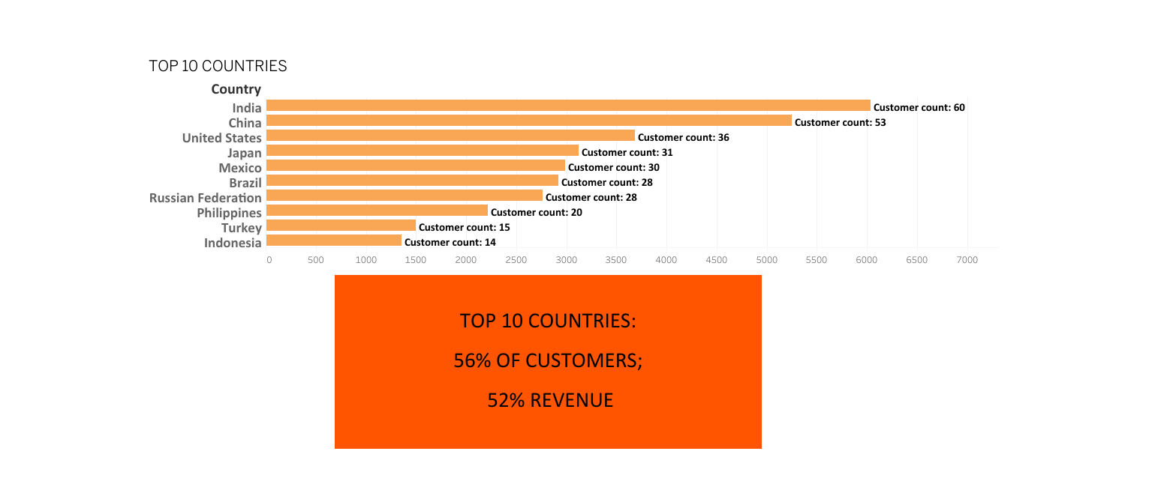
TOP 10 COUNTRIES

Slide 9
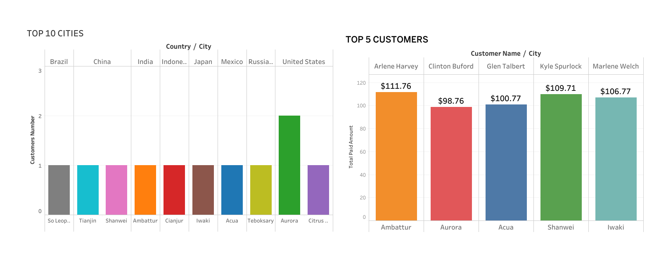
TOP 10 CITIES & TOP 5 CUSTOMERS

Slide 10
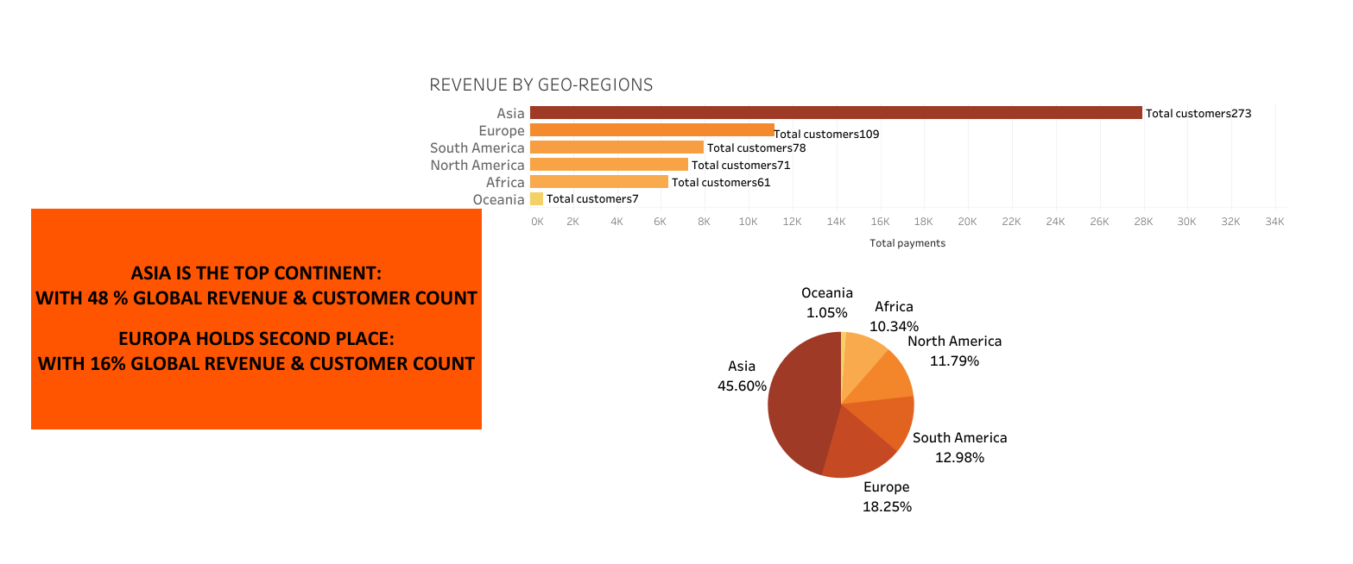
REVENUE BY GEO - REGIONS

Slide 11
RECOMENDATIONS
INVENTORY - Invest in more movies in categories like Sport, Animation, Action, Family and Sci-Fi
RENTAL DURATION - Create a better rental experience by ensuring availability in popular categories and offering a diverse selection to keep customers engaged and satisfied for longer periods
HIGH-REVENUE MARKETS - Direct promotional efforts and marketing resources to the top 10 countries: India, China, USA, Japan, Mexico, Brazil, Russian Federation, Philippines, Turkey and Indonesia
CUSTOMER LOYALTY - Introduce Customer Loyalty Program and Top Customer Rewards
GLOBAL FOCUS - Develop European , American and African market for new customer acquisition

Slide 12


THANK YOU VERY MUCH!
Link to Tableau dynamic presentation - https://public.tableau.com/authoring/RockbusterDataAnalysisProjectP_Kletnikoski/Story1#1
IF YOU HAVE ANY QUESTIONS PLES REACH ME AT
PKLETNIKOSKI@GMAIL.COM

